Slide 1

A dip into R for decision modelling
Howard Thom ^{a,b}
ª Surgical Innovation theme of the National Institute for Health Research (NIHR) Bristol Biomedical Research Centre (BRC), Bristol Medical School, University of Bristol, Bristol, UK
^{b} MRC ConDuCT-II Hub for Trials Methodology Research (Collaboration and Innovation for Difficult or Complex Randomised Controlled Trials in Invasive Procedures), Bristol Medical School, University of Bristol, Bristol, UK

Slide 2
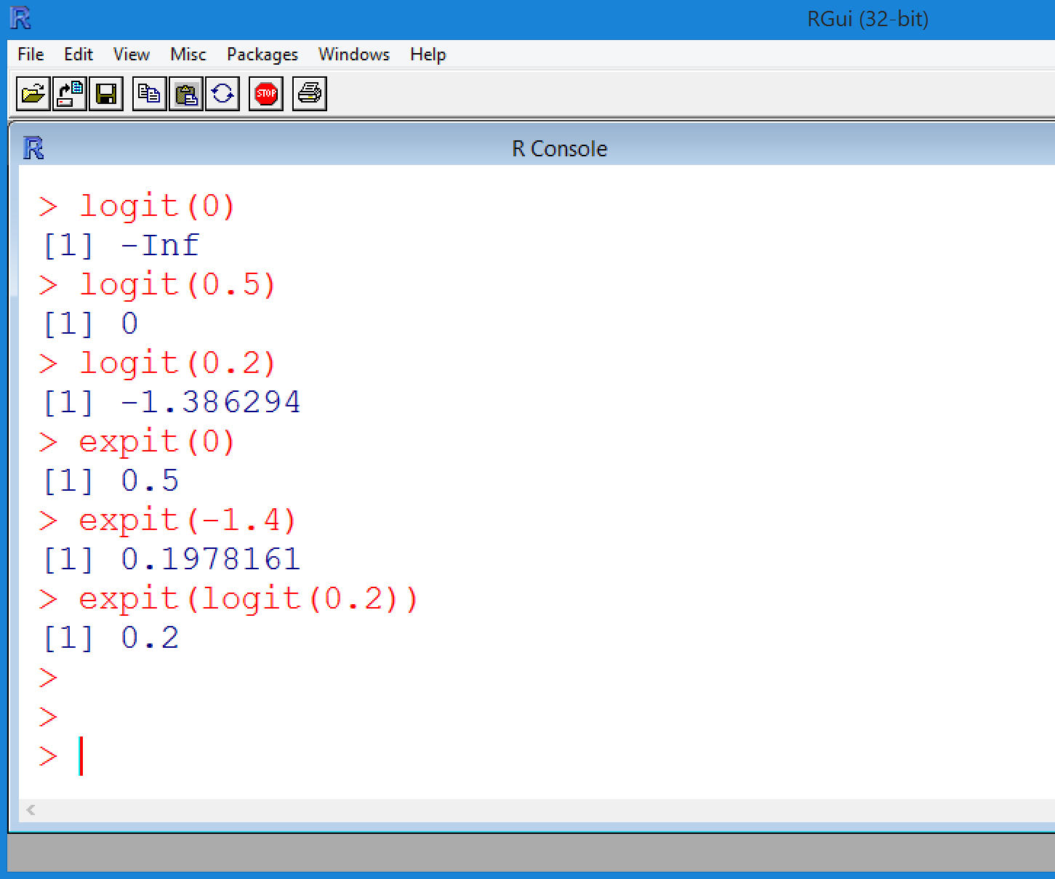
Simple functions – logit and its inverse
# Logistic link function
logit<-function(x)
{
return(log(x/(1-x)))
}
# Inverse of logit
expit<-function(x)
{
return(1/(1+exp(-x)))
}

Slide 3
Simple decision tree in R
Consider this simple decision tree with artificial input parameters.
Probabilities of recovery and relapse for no treatment (option 1), cognitive behavioural therapy (option 2), and antidepressants (option 3).
This toy model is available on GitHub: https://github.com/Bogdasayen/Depression-toy-decision-tree-in-R

Slide 4
Implementing a decision tree in R
QALYs if recover
QALYs if relapse
QALYs if no recovery
effects<-p.rec*(1-p.rel)*q.rec+p.rec*p.rel*q.rel+(1-p.rec)*q.norec
costs<-c.treat+p.rec*(1-p.rel)*c.rec+p.rec*p.rel*c.rel+(1-p.rec)*c.norec
net.benefit<-lambda*effects-costs
incremental.nb<-net.benefit-net.benefit[,1]
Treatment cost
Recovery cost
Relapse cost
No recovery cost

Slide 5
Implementing a decision tree in R
These four lines of code are the entire model!
effects<-p.rec*(1-p.rel)*q.rec+p.rec*p.rel*q.rel+(1-p.rec)*q.norec
costs<-c.treat+p.rec*(1-p.rel)*c.rec+p.rec*p.rel*c.rel+(1-p.rec)*c.norec
net.benefit<-lambda*effects-costs
incremental.nb<-net.benefit-net.benefit[,1]
And now we make it probabilistic…

Slide 6
Making it probabilistic (model code)
See any difference?
R performs the same calculations whether the p.rec and other variables are vectors or scalars
effects<-p.rec*(1-p.rel)*q.rec+p.rec*p.rel*q.rel+(1-p.rec)*q.norec
costs<-c.treat+p.rec*(1-p.rel)*c.rec+p.rec*p.rel*c.rel+(1-p.rec)*c.norec
net.benefit<-lambda*effects-costs
incremental.nb<-net.benefit-net.benefit[,1]

Slide 7
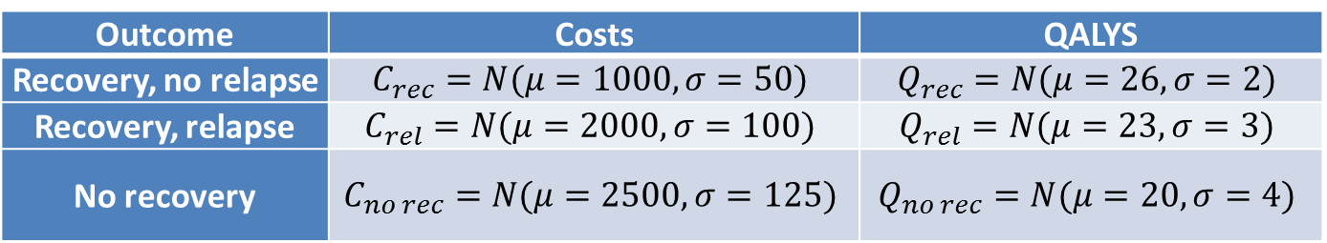
Making it probabilistic (Costs, Utilities)
Outcome | Costs | QALYS
Recovery, no relapse | $$C_{rec}=N(μ=1000,σ=50)$$ | $$Q_{rec}=N(μ=26,σ=2)$$
Recovery, relapse | $$C_{rel}=N(μ=2000,σ=100)$$ | $$Q_{rel}=N(μ=23,σ=3)$$
No recovery | $$C_{no rec}=N(μ=2500,σ=125)$$ | $$Q_{no rec}=N(μ=20,σ=4)$$
# Costs for recovery, relapse, and no recovery
c.rec<-rnorm(n=n.samples, mean=1000, sd=50)
c.rel<-rnorm(n=n.samples, mean=2000, sd=100)
c.norec<-rnorm(n=n.samples, mean=2500, sd=125)
# QALYs for recovery, relapse, and no recovery
q.rec<-rnorm(n=n.samples, mean=26, sd=2)
q.rel<-rnorm(n=n.samples, mean=23, sd=3)
q.norec<-rnorm(n=n.samples, mean=20, sd=4)

Slide 8
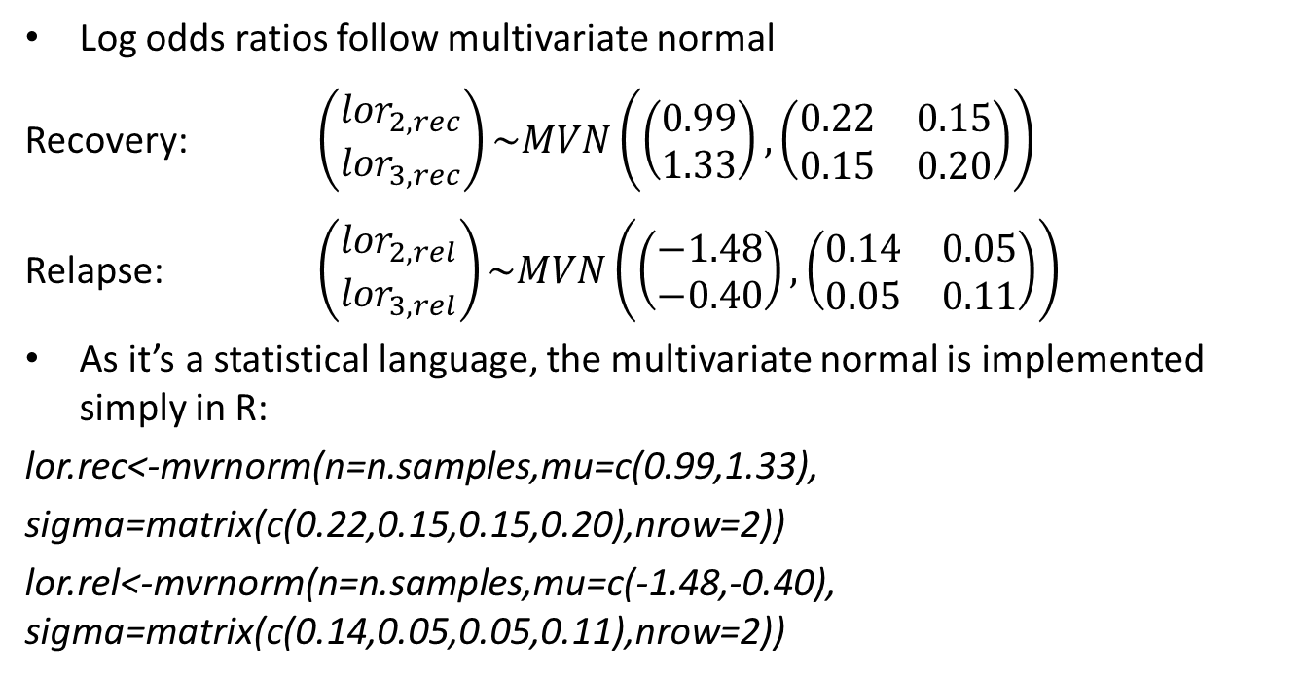
Making it probabilistic (Treatment effects)
Log odds ratios follow multivariate normal
Recovery: $\left(\begin{matrix}{lor}_{2,rec} \\ {lor}_{3,rec}\end{matrix}\right)\sim MVN\left(\left(\begin{matrix}0.99 \\ 1.33\end{matrix}\right),\left(\begin{matrix}0.22 & 0.15 \\ 0.15 & 0.20\end{matrix}\right)\right)$
Relapse: $\left(\begin{matrix}{lor}_{2,rel} \\ {lor}_{3,rel}\end{matrix}\right)\sim MVN\left(\left(\begin{matrix}−1.48 \\ −0.40\end{matrix}\right),\left(\begin{matrix}0.14 & 0.05 \\ 0.05 & 0.11\end{matrix}\right)\right)$
As it’s a statistical language, the multivariate normal is implemented simply in R:
lor.rec<-mvrnorm(n=n.samples,mu=c(0.99,1.33),
sigma=matrix(c(0.22,0.15,0.15,0.20),nrow=2))
lor.rel<-mvrnorm(n=n.samples,mu=c(-1.48,-0.40), sigma=matrix(c(0.14,0.05,0.05,0.11),nrow=2))

Slide 9
Instead use MCMC via R2OpenBUGS
Link directly with network meta-analysis code in OpenBUGS (or JAGS/STAN etc.)
library(R2OpenBUGS)
Load some BUGS model file
source("fixed.effects.binary.R")
Set simulation parameters
n.chains<-2; num.sims<-10000*n.chains; burn.in<-50000*n.chains
Call R2OpenBUGS key function
bugs.object<-bugs(data=bugs.data.recovery,inits=NA,model=fixed.effects.binary…)
Then get parameter samples from bugs.object$sims.array

Slide 10
Instead MCMC via R2OpenBUGS
Or load precalculated log odds ratios for recovery (similarly for relapse)
mcmc.recovery<-read.csv(file=“lor.recovery.bugs.csv”)
Can use just the first n.samples of the matrix
lor.rec<-mcmc.recovery[1:n.samples,]

Slide 11
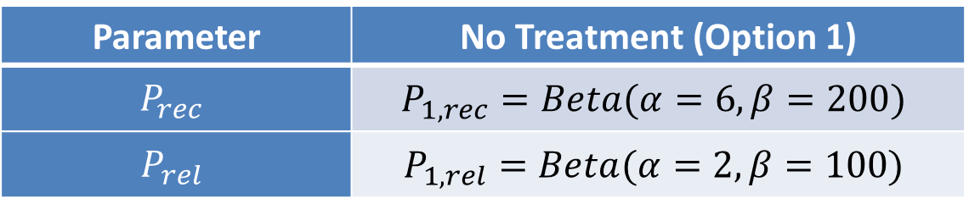
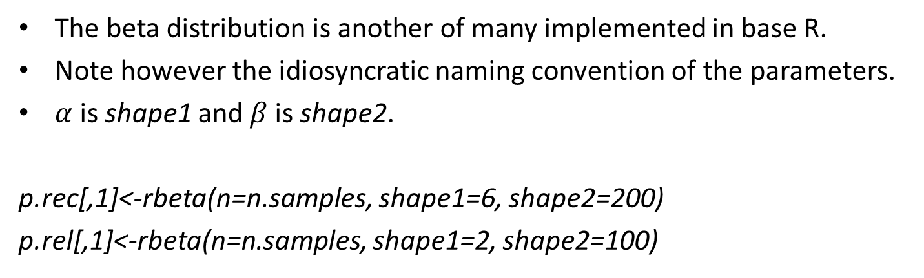
Making it probabilistic (Reference probabilities)
Parameter | No Treatment (Option 1)
$$P_{rec}$$ | $$P_{1, rec}=Beta(α=6,β=200)$$
$$P_{rel}$$ | $$P_{1,rel}=Beta(α=2,β=100)$$
The beta distribution is another of many implemented in base R.
Note however the idiosyncratic naming convention of the parameters.
$α$ is shape1 and $β$ is shape2.
p.rec[,1]<-rbeta(n=n.samples, shape1=6, shape2=200)
p.rel[,1]<-rbeta(n=n.samples, shape1=2, shape2=100)

Slide 12
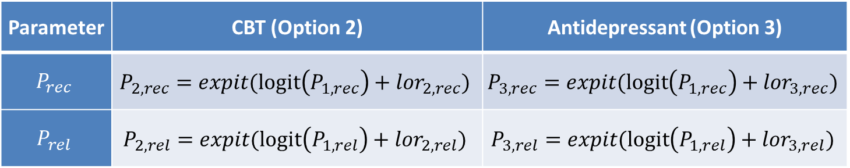
Making it probabilistic (Comparator probabilities)
Parameter | CBT (Option 2) | Antidepressant (Option 3)
$$P_{rec}$$ | $$P_{2, rec}=expit(logit\left(P_{1, rec}\right)+{lor}_{2,rec})$$ | $$P_{3, rec}=expit(logit\left(P_{1, rec}\right)+{lor}_{3,rec})$$
$$P_{rel}$$ | $$P_{2, rel}=expit(logit\left(P_{1, rel}\right)+{lor}_{2,rel})$$ | $$P_{3,rel}=expit(logit\left(P_{1, rel}\right)+{lor}_{3,rel})$$
We can use a loop over the number of treatments n.treat
for(i in 2:n.treat){
p.rec[,i]<-expit(logit(p.rec[,1])+lor.rec[,i-1])
p.rel[,i]<-expit(logit(p.rel[,1])+lor.rel[,i-1])
}

Slide 13
Making it probabilistic - vectorise
Parameter | CBT (Option 2) | Antidepressant (Option 3)
$$P_{rec}$$ | $$P_{2, rec}=expit(logit\left(P_{1, rec}\right)+{lor}_{2,rec})$$ | $$P_{3, rec}=expit(logit\left(P_{1, rec}\right)+{lor}_{3,rec})$$
$$P_{rel}$$ | $$P_{2, rel}=expit(logit\left(P_{1, rel}\right)+{lor}_{2,rel})$$ | $$P_{3,rel}=expit(logit\left(P_{1, rel}\right)+{lor}_{3,rel})$$
Or we can vectorise, which is much faster than a loop
p.rec[,c(2:n.treat)]<-expit(logit(p.rec[,1])+lor.rec[,c(2:n.treat)-1])
p.rel[,c(2:n.treat)]<-expit(logit(p.rel[,1])+lor.rel[,c(2:n.treat)-1])
The expit and logit functions work on vectors and matrices.
Can set n.treat to any number without having to duplicate code.

Slide 14
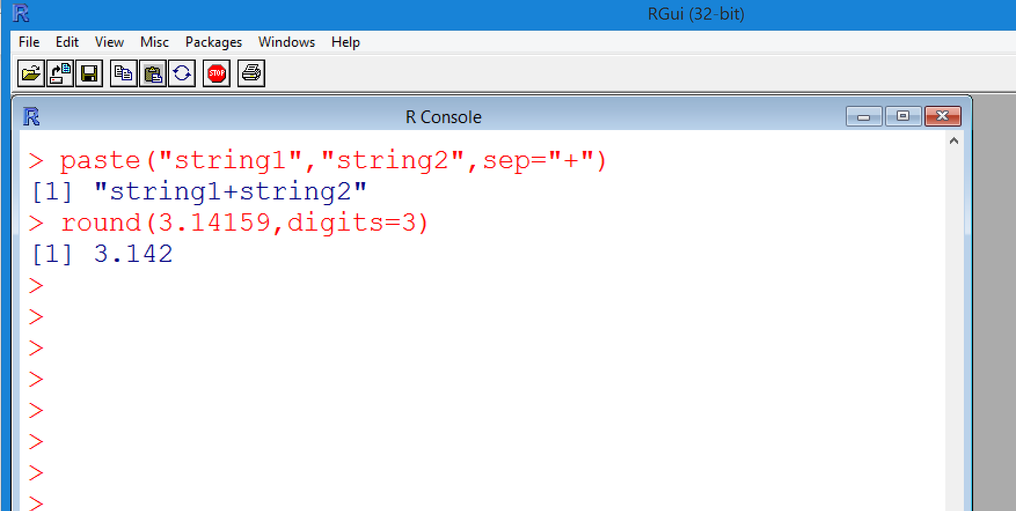

Formatting results
Use paste(“string1”, “string2”) function for string concatenation
Use round(x,digits=3) for numeric formatting
format.results<-function(x,digits=2)
{
paste(round(mean(x),digits=digits)," (",round(quantile(x,probs=0.025),digits=digits),", ",round(quantile(x,probs=0.975),digits=digits),")",sep="")
}

Slide 15
Decision tree results
Build a results matrix
results.matrix<-matrix(NA, nrow=4,ncol=n.treat)
Name the rows and columns
rownames(results.matrix)<-c("Total costs","Total QALYs", "Net Benefit","Incremental NB")
colnames(results.matrix)<-t.names
Then calculate summaries
for(i.treat in 1:n.treat)
{
results.matrix["Total costs",i.treat]<-format.results(x=costs[,i.treat])
results.matrix["Total QALYs",i.treat]<-format.results(x=effects[,i.treat])
results.matrix["Net Benefit",i.treat]<-format.results(x=net.benefit[,i.treat])
results.matrix["Incremental NB",i.treat]<-format.results(x=incremental.nb[,i.treat])
}

Slide 16
Exporting the results matrix to Excel
Export as a csv
write.csv(results.matrix, file="depression.results.csv")
Or as an Excel file
library(xlsx)
write.xlsx(results.matrix, file="depression.results.xlsx", sheetName="CEA results")
 | No treatment | CBT | Antidepressant
Total costs | 2458.08 (2216.38, 2692.91) | 2678.9 (2424.37, 2937.03) | 2366.58 (2087.97, 2621.49)
Total QALYs | 20.09 (12.87, 27.59) | 20.41 (13.54, 27.56) | 20.59 (14.02, 27.52)
Net Benefit | 399358.81 (254931.73, 549117.1) | 405521.49 (267937.64, 548404.61) | 409355.48 (277952.91, 548049.21)
Incremental NB | 0 (0, 0) | 6162.68 (-1978.38, 26095.58) | 9996.67 (-2660.86, 36001.2)
So you can link back to Excel if you really can’t resist.

Slide 17
And next?
The model is available for you to try:
https://github.com/Bogdasayen/Depression-toy-decision-tree-in-R
A full Markov cost-effectiveness model is also available:
https://github.com/Bogdasayen/DOACs-AF-Economic-model
Bristol University will run a 2-day introductory course on R for Economic Evaluation.
Internal pilot in 2019, open externally in 2020.

Slide 18

Thank you!
The HTMR Collaboration and innovation in Difficult and Complex randomised controlled Trials In Invasive procedures (ConDuCT-II) hub provided support for this research.
This study was supported by the NIHR Biomedical Research Centre at the University Hospitals Bristol NHS Foundation Trust and the University of Bristol. The views expressed in this presentation are those of the author(s) and not necessarily those of the NHS, the National Institute for Health Research or the Department of Health.

